Slide 1
Team UNDEFINED
Meenakshi Balgobin
Ashish Venkiah
Nikhil Ken Ramessur
Yuvraj Seegolam

Slide 2
Topic
On the the 17th of June 2022, the U.S Food & Drug Administration authorized use of moderna & Pfizer vaccine to children down to 6 months.
How do people feel about this?

Slide 3
Why
To analyse US citizens opinions
For other countries to analyse the impact of this decision

Slide 4
Query Visualization
AND
AND
covid
vaccine
child
child
OR kids OR baby
OR children
OR toddler
OR young
OR infants
OR kid
coronavirus
OR covid
OR covid19
OR #COVID19
vaccine
OR vaccination
OR shot
OR vaccinated
OR vaccinate

Slide 5
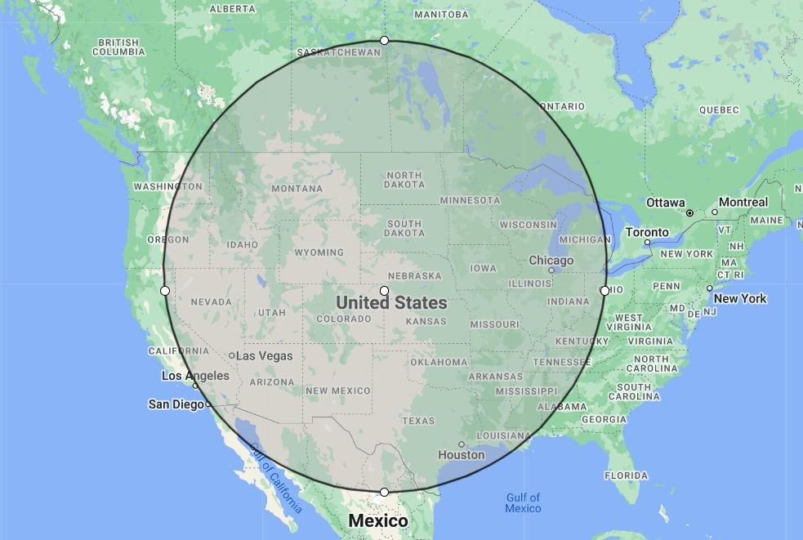
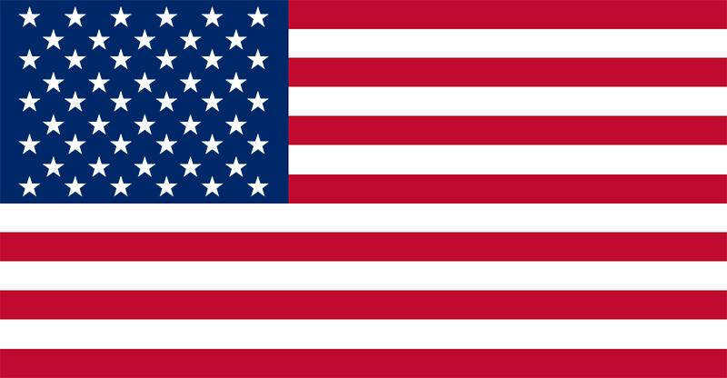
Target Locations
1600 km
United States
Latitude: 39.036356,
Longitude: -101.575207

Slide 6
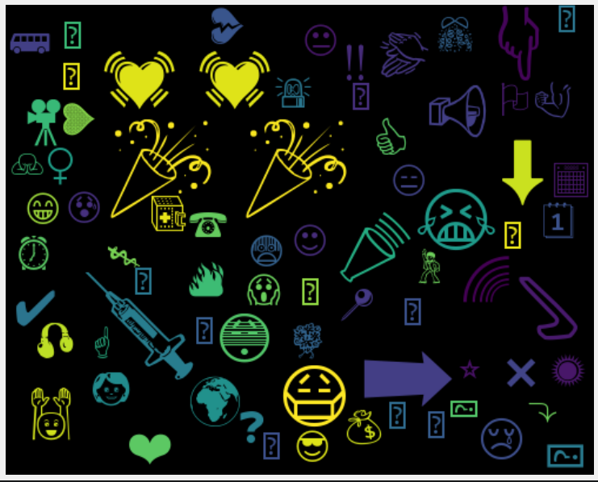
Data
Exploration
1000 tweets
7% tweets have emojis
114 duplicates found
189 characters in average
88% tweets have uppercase words
Emoji cloud

Slide 7
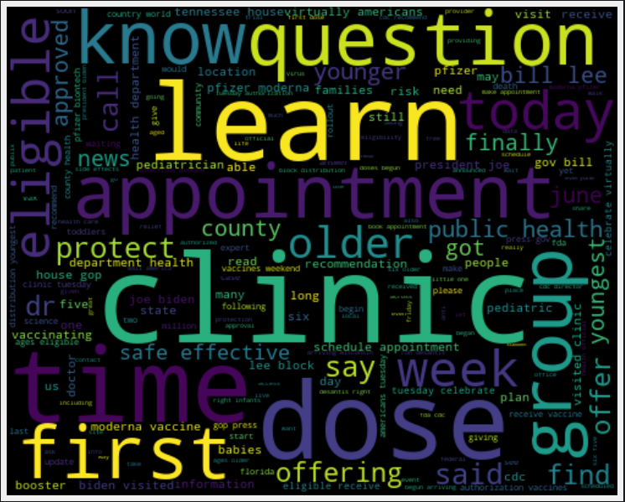
Data Pre-Processing
Remove links, mentions
Remove 114 duplicates
Remove stopwords for TextBlob

Slide 8
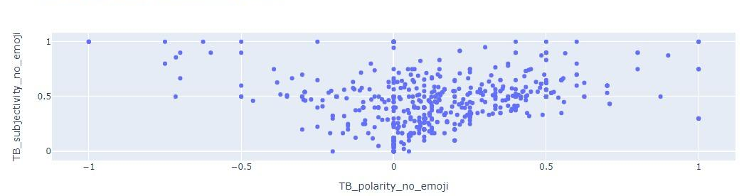
Sentiment Analysis - TextBlob
Most of the tweets are Neutral or Positive
Most of the tweets are Factual

Slide 9
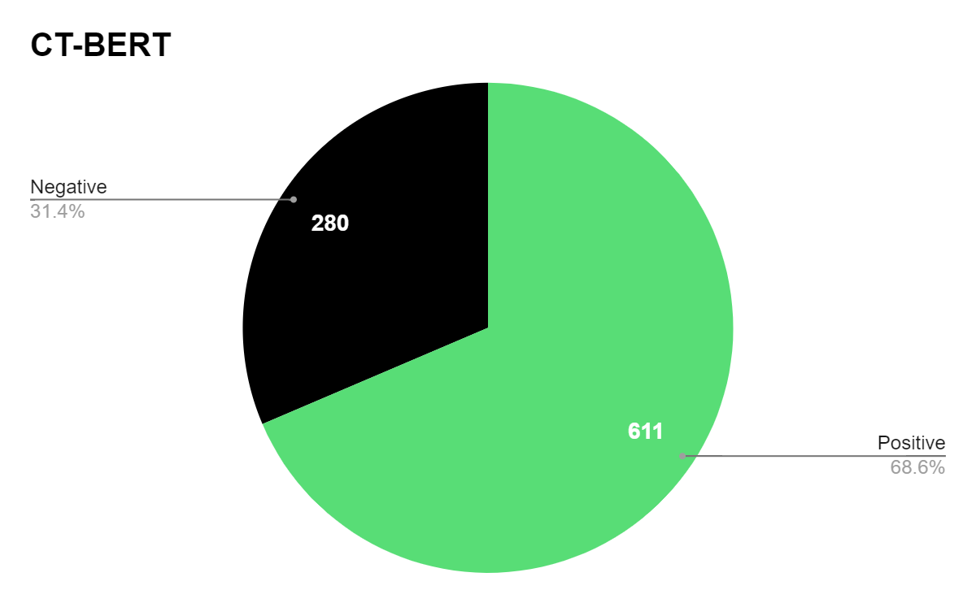
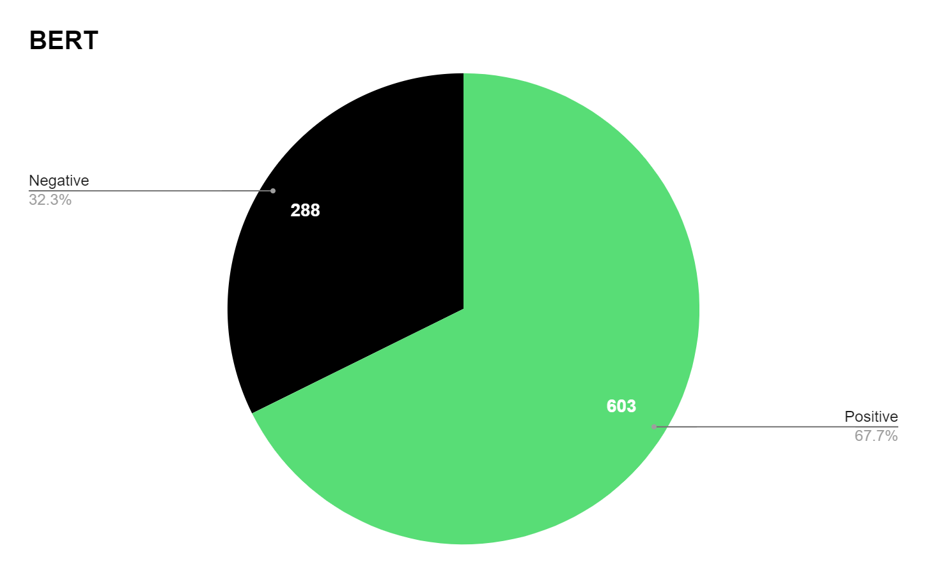
Sentiment Analysis - CT-BERT

Slide 10
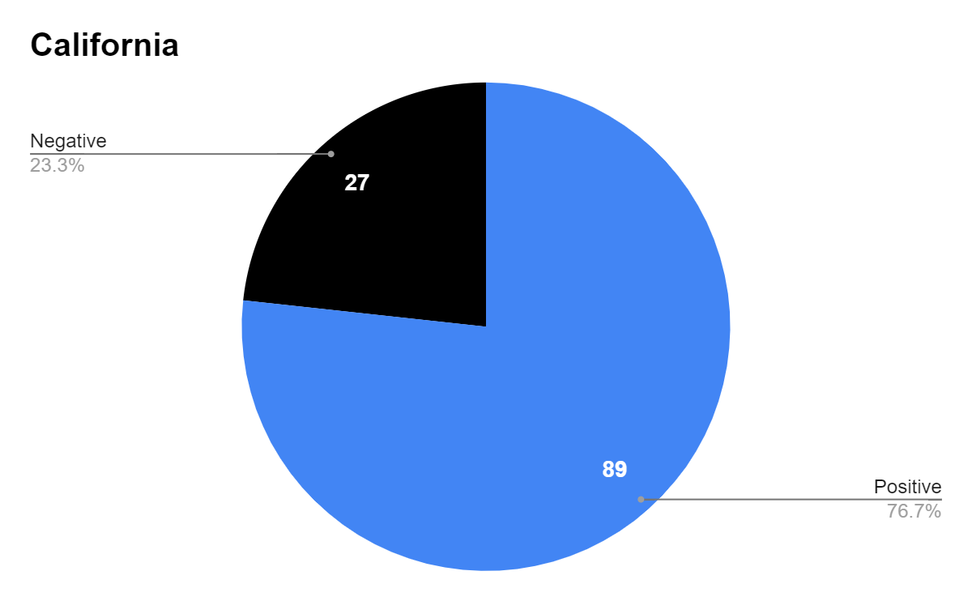
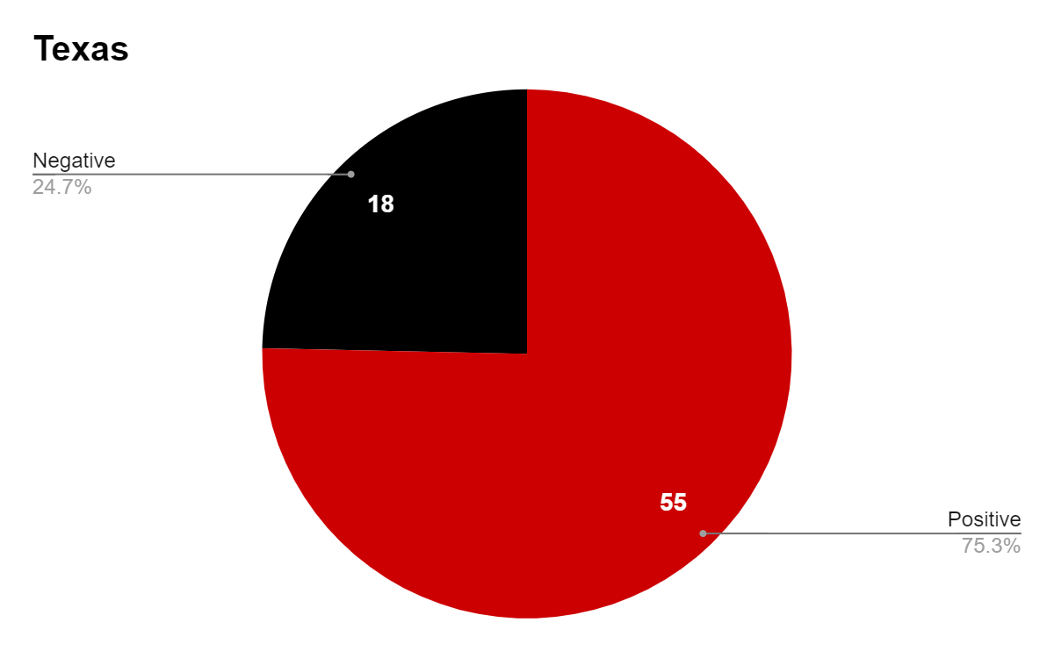
Impact of Politics
Blue State
Red State

Slide 11

Side Quest - Emoji Processing
3. Append to tweet text
Extract emojis in tweets
Existing text
+
Emoji text
Happy
face
2. Convert to Text

Slide 12
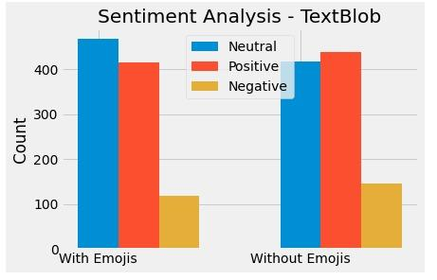
Side Quest - Impact of Emojis
Emojis increase Neutrality of tweets

Slide 13
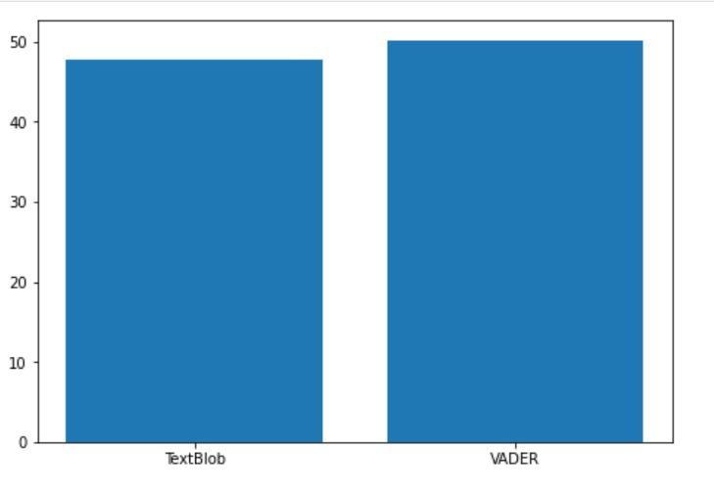
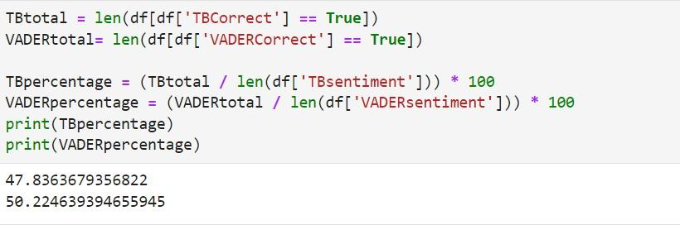
Additional challenges
Q1: For what percentage of tweets did the TextBlob & VADER tools predict correctly the sentiment? Which model performs better?
VADER performs slightly better (~ 2%)

Slide 14
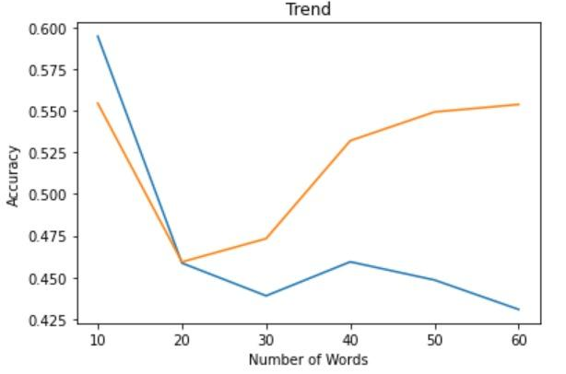
Additional challenges
Q2: For each models, does the number of words (or chars) in a tweet affect the accuracy of the assigned sentiment
VADER
TextBlob

Slide 15
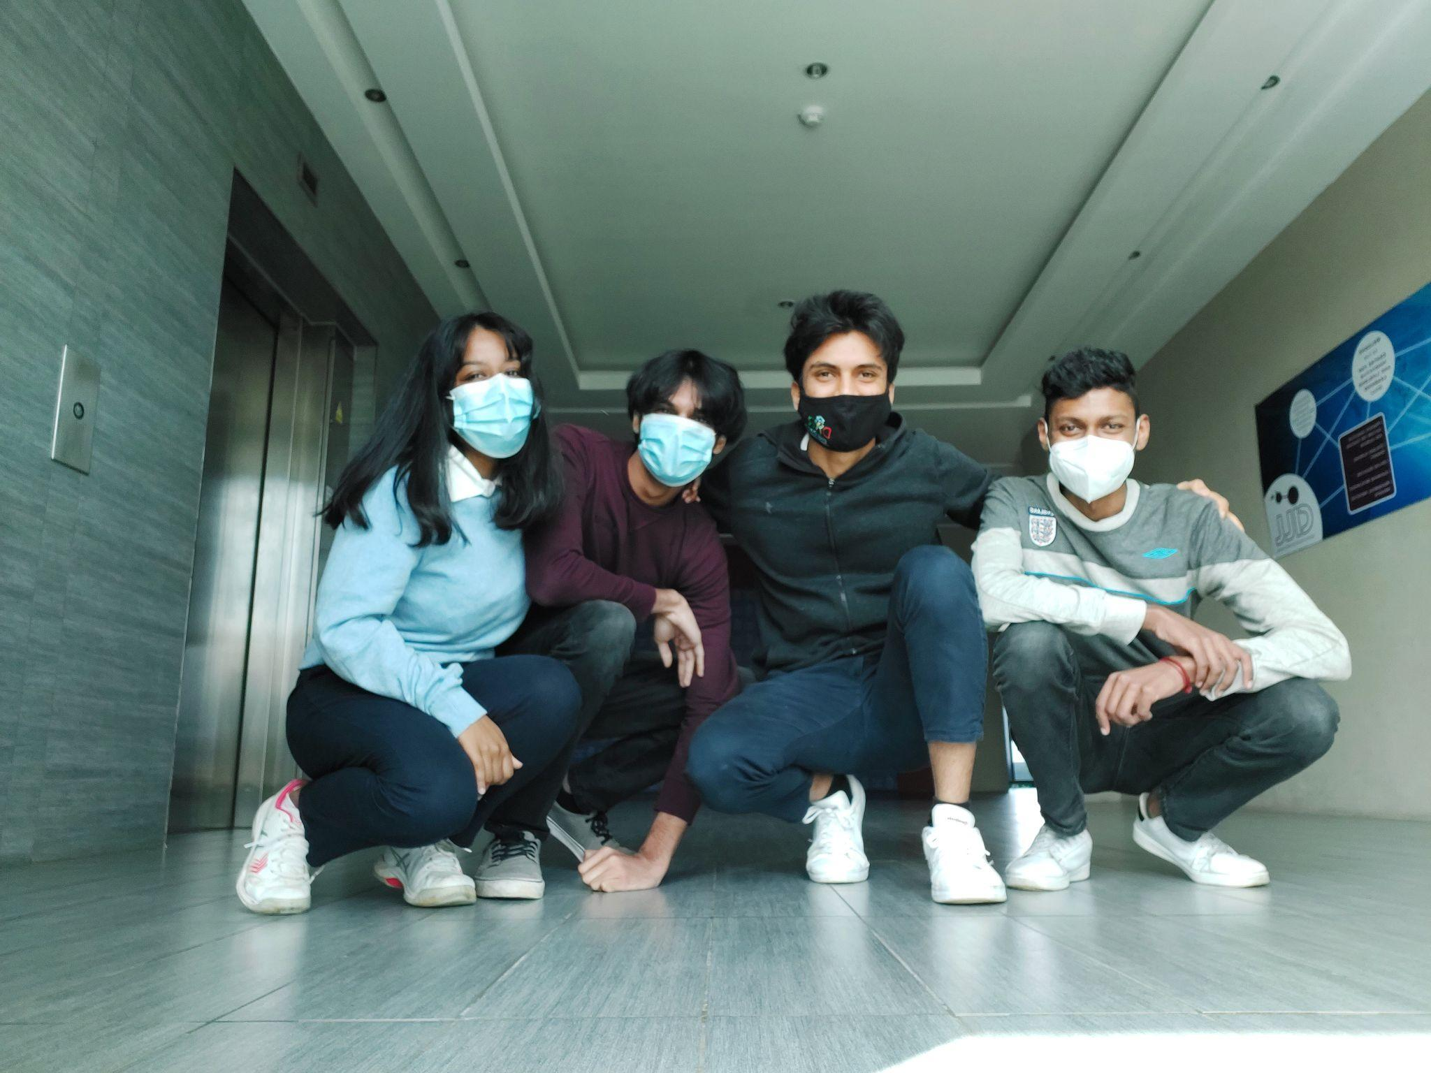
Conclusion!
Any Questions ?
Team UNDEFINED

